Slide 1

Safety and robustness verification of Autoencoder (For regression ) Nithin K Guruswamy and Neelanjana PAL

Slide 2
Introduction
Autoencoder is a self supervised NN which is used in regression (forecasting) and anomaly detection.
Autoencoder is verified for regression problem using NNV tool
Data set used is credit card usage dataset which has 29 dimensions like time of transaction, amount of transaction etc.

Slide 3
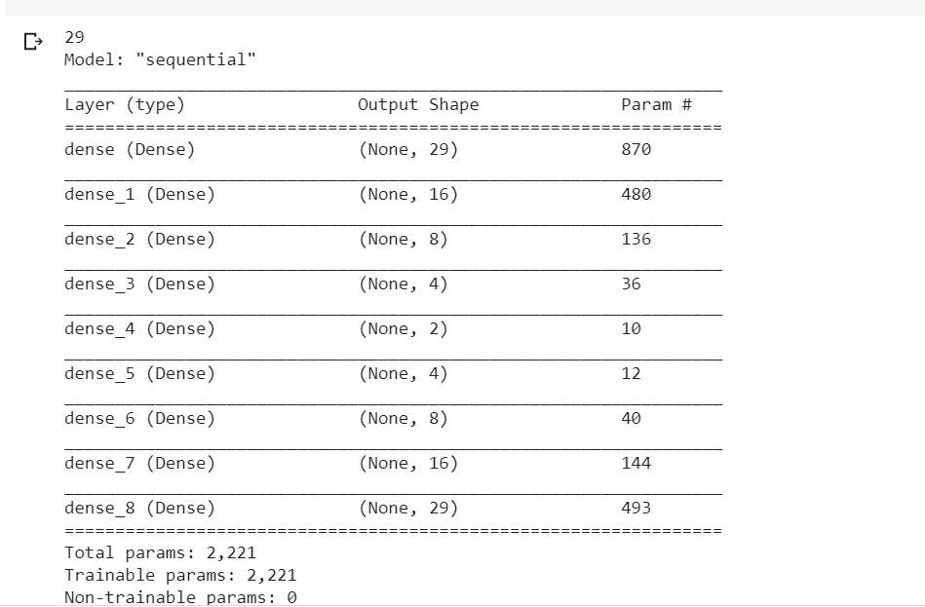
Autoencoder model
The Autoencoder model architecture is shown in the right side
It is trained using (160000, 29) good training data from credit card usage.
The model is then converted into a matlab model and then to nnv tool compatible CNN model

Slide 4
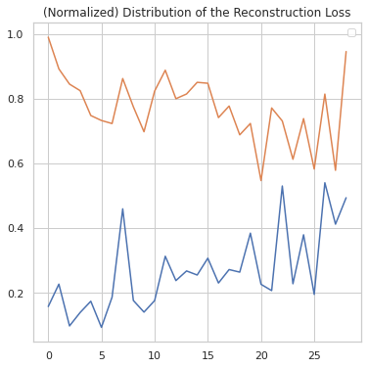
Input test data
input data size is (84807, 29)
the lower bound and upper bound is selected as mean -/+ 2 sigma as shown
The input is converted to star set
Then it is converted to image star set suitable for feeding to CNN based nnv tool.

Slide 5
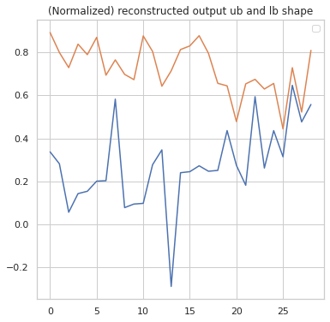
Output from NNV tool
The starset output from nnv tool is as shown above.
The reconstructed output for the input from keras is as shown below
So, the keras output (shown below) is within the thresholds of starset output (above figure) and is within the reachable set.
This verifies the autoencoder for regression.

Slide 6
Demo!

Slide 7
References and Q&A
https://www.kaggle.com/robinteuwens/anomaly-detection-with-auto-encoders/notebook
https://github.com/verivital/nnv

